Slide 1
IP Protocol Addresses
COSC 350

Slide 2
Motivation
One key aspect of virtual network is single, uniform address format -> seamless communication
Can't use hardware (MAC) addresses because different technologies have different address formats
Address format must be independent of any particular hardware address format
Sending host puts destination internet address in packet
Destination address can be interpreted by any intermediate router
Routers examine address and forward packet on to the destination

Slide 3
TCP/IP addresses
Addressing in TCP/IP is specified by the Internet Protocol (IP)
Each host is assigned a 32-bit number
Called the IP address or Internet address
Unique across entire Internet
When sending a packet across the Internet, sender’s protocol software must specify
its own 32-bit IP address (the source address)
and the address of the intended recipient (the destination address)

Slide 4
IP address hierarchy
Each IP address is divided into a prefix and a suffix
Prefix identifies network to which computer is attached -> network (+ sub network) address
Suffix identifies computer within that network -> host address
Address format makes routing efficient
Routers look for network address

Slide 5
Network and host numbers
Every network (LAN) in a TCP/IP internet is assigned a unique network number that must be coordinated globally
Each host on a specific network is assigned a host number or host address that is unique within that network
Host address may be reused and should be managed locally

Slide 6
Properties of IP addresses
Network numbers are unique
IP address = Network number (prefix) + Host address (suffix)
Host addresses may be reused on different networks
Assignment of network numbers must be coordinated globally
Assignment of host addresses can be managed locally

Slide 7
Properties of IP addresses cont’
Make sense only when it is converted to a binary number
Main responsibility is to find out network address from IP address and to route to corresponding LAN
R
LAN B
LAN A
All these stations share the same network ID but have unique host address in LAN B (network ID + host address)

Slide 8
Designing the format of IP addresses
IP designers chose 32-bit addresses
Allocate some bits for prefix, some for suffix
Large prefix, small suffix - many networks, few hosts per network
Small prefix, large suffix - few networks, many hosts per network
Because of variety of technologies, need to allow for both large and small networks

Slide 9
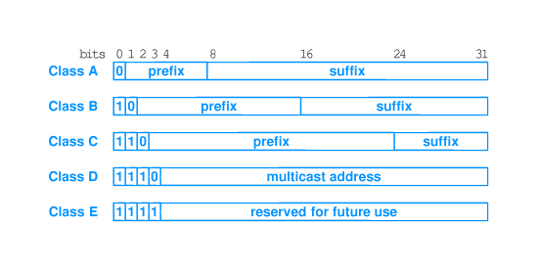
Classes of addresses
Designers chose a compromise - multiple address formats that allow both large and small prefixes
Each format is called an address class
Class of an address is identified by first four bits

Slide 10
Using IP address classes
Class A, B and C are primary classes
Used for ordinary host addressing
Class D is used for multicast, a limited form of broadcast
Internet hosts join a multicast group
Packets are delivered to all members of group
Routers manage delivery of single packet from source to all members of multicast group
Used for mbone (multicast backbone)
Class E is reserved
The first four bits of an IP address determined the class to which the address belonged
It specifies how the remainder of the address was divided into prefix and suffix

Slide 11
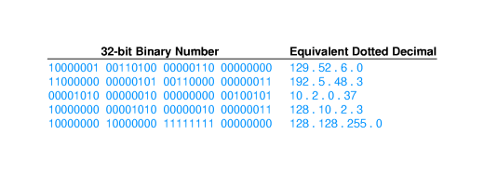
Dotted decimal notation
Class A, B and C all break between prefix and suffix on byte boundary
Dotted decimal notation is a convention for representing 32-bit internet addresses in decimal
Convert each byte of address into decimal; display separated by periods (``dots'')

Slide 12
Towson's IP addresses
Towson University has:
A total of 21,504 IPv4 addresses distributed across three main IP ranges
136.160.128.0/18 (16,384 addresses)
204.62.32.0 / 20 (4,096 addresses)
204.62.48.0 / 22 (1,024 addresses)
No IP V6 registered
Most of end-user stations use private addresses which must be mapped to some public IP address to communicate with the stations located outside of LAN environment
Suffix bytes are used to determine local network and host through subnetting

Slide 13
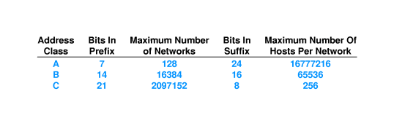
Networks and hosts in each class
Classing scheme does not yield equal number of networks in each class
Class A:
First bit must be 0
7 remaining bits identify Class A net
2⁷ (= 128) possible class A nets – contains half of all addresses

Slide 14
Internet address allocation
Addresses in the Internet are not used efficiently
Large organizations may not be able to get as many addresses in the Internet as they need
Example - UPS needs addresses for millions of computers
Solution - set up private internet and allocate addresses from entire 32-bit address space
Connection to the Internet through IP masquerading

Slide 15
Authority for Addresses
Internet Corporation for Assigned Names and Numbers (ICANN) authority has been established
to handle address assignment and adjudicate disputes
ICANN does not assign individual prefixes
Instead, ICANN authorizes a set of registrars to do so
Registrars make blocks of addresses available to ISPs
ISPs provide addresses to subscribers
To obtain a prefix
a corporation usually contacts an ISP

Slide 16
Subnet and Classless Addressing
Classful addressing scheme became a limitation
The demands for class A or class B exceed the capacity
Many class C addresses still remained but less demands
Two mechanisms to overcome the limitation:
Subnet addressing
Classless addressing
The two mechanisms are closely related
Multiple IP address classes can be combined by using prefix/suffix appropriately

Slide 17
Subnet and Classless Addressing
Subnet addressing: used within large organizations
Classless addressing extended the approach to all Internet
Consider a network that contains 55 hosts
classful addressing requires a complete class C prefix
In classless addressing:
a prefix that is 26 bits long
a suffix that is 6 bits long

Slide 18
Subnet and Classless Addressing
With classless addressing
Divide the prefix into several longer prefixes
Figure 21.4 illustrates how to divide a class C prefix into four (4) longer prefixes
Each one contains up to 62 hosts
The original class C address has 8 bits of suffix
the classless addresses has 6 bits of suffix
ISP can assign each of the four (4) classless prefixes to a subscriber

Slide 19
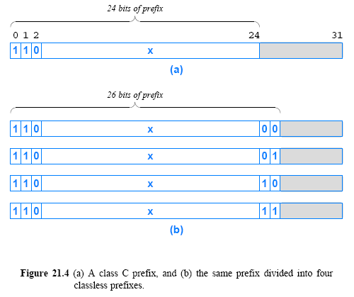

Slide 20
Address Masks
The classless and subnet addressing schemes require an additional piece of information:
A value that specifies the exact boundary
To mark the boundary, IP uses a 32-bit value
known as an address mask, also called a subnet mask
A mask makes processing efficient
Hosts and routers compare the network prefix portion of the address to a value in their forwarding tables

Slide 21
Address Masks cont’
Suppose a router is given
a destination address, D
a network prefix represented as a 32-bit value, N
a 32-bit address mask, M
Assume the top bits of N contain a network prefix, and the remaining bits have been set to zero
To test whether the destination lies on the specified network, the router tests the condition:
N == (D & M)
The router
uses the mask with a “logical and (&)” operation to set the host bits of address D to zero (0)
and then compares the result with the network prefix N

Slide 22
Address Masks cont’
As an example:
Consider the following 32-bit network prefix:
10000000 00001010 00000000 00000000 = 128.10.0.0
Consider a 32-bit mask:
11111111 11111111 00000000 00000000 = 255.255.0.0
Consider a 32-bit destination address, which has a
10000000 00001010 00000010 00000011 = 128.10.2.3
A logical and between the destination address and the address mask extracts the high-order 16-bits
10000000 00001010 00000000 00000000 = 128.10.0.0

Slide 23
CIDR Notation
Classless Inter-Domain Routing (CIDR)
Make it easy for a human to specify a mask
Consider the mask needed for the example in Figure 21.4b
It has 26 bits of 1s followed by 6 bits of 0s
In dotted decimal, the mask is: 255.255.255.192
The general form -> ddd.ddd.ddd.ddd/m
ddd is the decimal value for an octet of the address
m is the number of one bits in the mask
E.g.: 192.5.48.69/26 specifies a mask of 26 bits

Slide 24
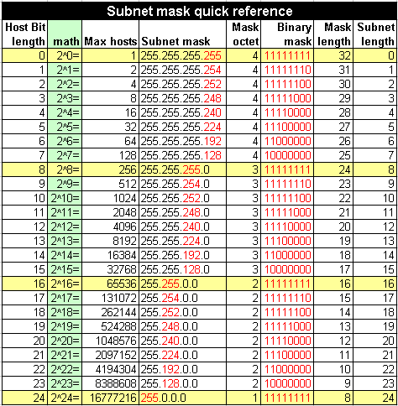
Figure C
**Eight special numbers that reoccur when dealing with subnets:
255, 254, 252, 248, 240, 224, 192, 128
Useful links:
IP subnetting made easy
Subnet-calculate.com

Slide 25
A CIDR Example
Assume an ISP has the following block 128.211.0.0/16
Suppose the ISP has 2 customers
one customer needs 12 IP addresses and the other needs 9
The ISP can assign
customer1 CIDR: 128.211.0.16/28
customer2 CIDR: 128.211.0.32/28
both customers have the same mask size (28 bits), the prefixes differ
The binary value assigned to customer1 is:
10000000 11010011 00000000 0001 0000
The binary value assigned to customer2 is:
10000000 11010011 00000000 0010 0000
There is no ambiguity
Each customer has a unique prefix
More important, the ISP retains most of the original address block
it can then allocate to other customers

Slide 26
CIDR Host Addresses
Once CIDR prefix is given
the customer can assign host addresses
E.g. 128.211.0.16/28
Figure 21.6 illustrates 4-bit host address field
Avoid assigning the all 1s and all 0s host addresses
Figure 21.6 illustrates a disadvantage of classless addressing
the host suffix can start on an arbitrary boundary
E.g.
Decimal values from 128.211.0.17 through 128.211.0.30

Slide 27
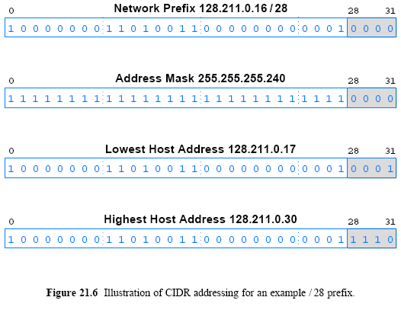

Slide 28
Special IP Addresses
IP defines a set of special address forms that are reserved
That is, special addresses are never assigned to hosts
This section describes both the syntax and semantics of each special address form
21.14.1 Network Address
21.14.2 Directed Broadcast Address
21.14.3 Limited Broadcast Address
21.14.4 This Computer Address
21.14.5 Loopback Address

Slide 29
Network Address
IP reserves host address zero to denote a network
E.g., the address 128.211.0.16/28 denotes a network
A network address should never appear as the destination address in a packet

Slide 30
Directed Broadcast Address
To simplify broadcasting (send to all)
IP defines a directed broadcast address for each physical network
When a packet is sent to a network's directed broadcast
a single copy of the packet travels across the Internet
until it reaches the specified network
the packet is then delivered to all hosts on the network
The directed broadcast address for a network is formed by adding a suffix that consists of all 1 bits

Slide 31
Directed Broadcast Address
How does broadcast work?
If network hardware supports broadcast
a directed broadcast will be delivered using the hardware broadcast capability
If a particular network does not have hardware support for broadcast
software must send a separate copy of the packet to each host on the network

Slide 32
Limited Broadcast Address
Limited broadcast refers to a broadcast on a directly-connected network
Limited broadcast is used during system startup
IP reserves the address consisting of 32-bits of 1s
IP will broadcast any packet sent to the all-1s address across the local network

Slide 33
This Computer Address
A computer needs to know its IP address
When the computer boots
The startup protocols also use an IP to communicate
When using such startup protocols
IP reserves the address that consists of all 0s to mean this computer

Slide 34
Loopback Address
Loopback address used to test network applications
Used for preliminary debugging for two application programs
The programs Use a loopback address when communicating
When one application sends data to another
data travels entire protocol stack to the IP software

Slide 35
Loopback Address
A programmer can test the program logic quickly
IP reserves the network prefix 127/8 for use with loopback
The host address used with 127 is irrelevant
all host addresses are treated the same
programmers often use host number 1 -> 127.0.0.1
During loopback testing no packets ever leave a computer
The loopback address never appears in a packet traveling across a network

Slide 36
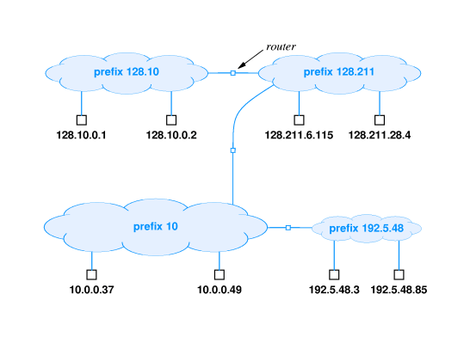
Example
Select address class for each network depending on expected number of hosts
Assign network numbers from appropriate classes
Assign host suffixes to form internet addresses for all hosts

Slide 37
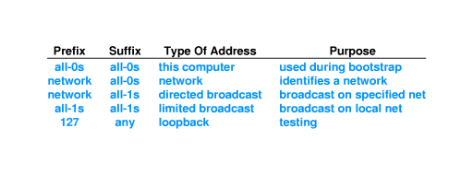
Special IP addresses

Slide 38
Routers and the IP Addressing Principle
Two or more IP addresses per router
A router has connections to multiple physical networks
Each IP address contains a prefix that specifies a physical network
Each address identifies a connection between a computer and a network

Slide 39
Routers and IP addressing
IP address depends on network address
What about routers - connected to two networks?
IP address specifies an interface, or network attachment point, not a computer
Router has multiple IP addresses - one for each interface

Slide 40
The default gateway
The basic IP configuration:
The IP address
The subnet mask
The default gateway

Slide 41
Assigning IP addresses
All devices on a subnet must share the same network ID
Subnets must have different network Ids than each other
Nodes on a local subnet must have unique node Ids
Node Ids on a remote subnet can duplicate node Ids on the local subnet
127.0.0.1 is reserved for loopback testing and can’t be used
The node address can’t be all ones or all zeros

Slide 42
Assigning IP addresses cont’
Non-routable IP address ranges:
10.0.0.0 ~ 10.255.255.255
168.254.0.0 ~ 168.254.255.255
172.16.0.0 ~ 172.31.255.255
192.168.0.0. ~ 192.168.255.255

Slide 43
Subnetting example
1. Subnetting 192.168.10.0 into 4 subnets
subnet mask? => 255.255.255.192
2. Calculating base network Ids
203.121.45.6/22 = 203.121.44.0, 224.210.100.5.18 = 224.210.64.0

Slide 44
Multi-homed hosts
Can a host connect to multiple networks? Yes
A host computer with multiple network connections is said to be multi-homed
Multi-homing is sometimes used to increase reliability
if one network fails, the host can still reach the Internet through the second connection
Alternatively, multi-homing is used to increase performance
connections to multiple networks can make it possible to send traffic directly and avoid routers, which are sometimes congested
Like a router, a multi-homed host has multiple protocol addresses
one for each network connection

